Slide 1
Quantitative Strategy Comparison
Active vs Passive
Quantitative Finance Course BUDL050 - Summer 2025
Chris, Aarnav, Sang, Nate

Slide 2
Abstract (Project Objective)
In this Project we are testing 5 different trading strategies.
Our Active Strategies are Mean Reversion, Trend Following, Momentum, and a Martingale Strategy.
Our Passive Strategy is just a simple buy on day 1 and sell on the last day.
Our goal is to find out which strategy is most effective under different market conditions.
  We are planning to analyze the profitability and risk profiles of the 2 strategies.

Slide 3

Introduction
In finance, investors use many strategies to navigate the unpredictable stock market and they try to maximize returns and manage risk.
Stock Market Investors and Quant Traders often debate:
  Are Active Strategies better then Passive Strategies (Buy and Hold)?
We tested this using daily data from 2020-2024 using 4 different stocks:
  Apple (Tech), Tesla (Auto/EV), XOM (Energy), and JNJ (Healthcare)

Slide 4
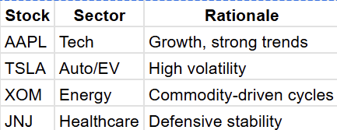
Stocks and Time Periods
these stocks because they covered multiple different sectors such as Tech, Automotive / EV , Energy, and Healthcare.
We are using daily data from the time period of 2020-2024.

Slide 5

Data Source
We used Quant Mod as a data source since it gave us access to Yahoo Finance Data.
Performance Analytics since it gave us a better ability to see the results of the code.
We used TTR since it includes many technical indicators (moving averages, RSI, MACD, and Bollinger Bands) that are important for developing and testing trading strategies.

Slide 6
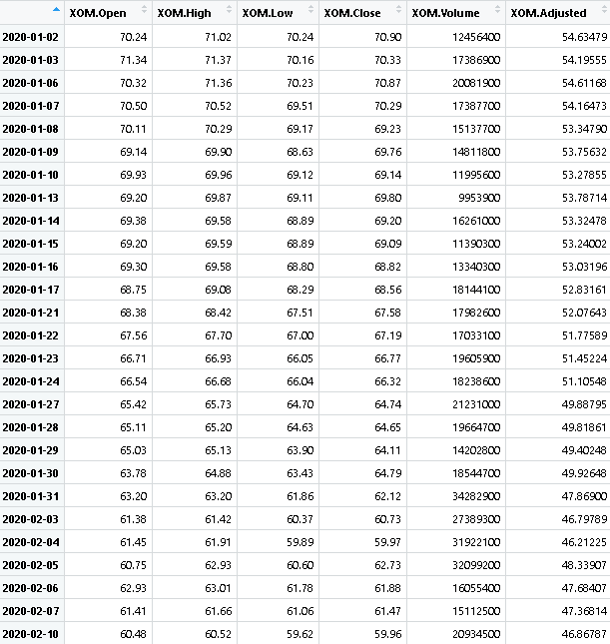
Sample Data Table
The data table shows the data for Exxon Mobil Corporation.

Slide 7
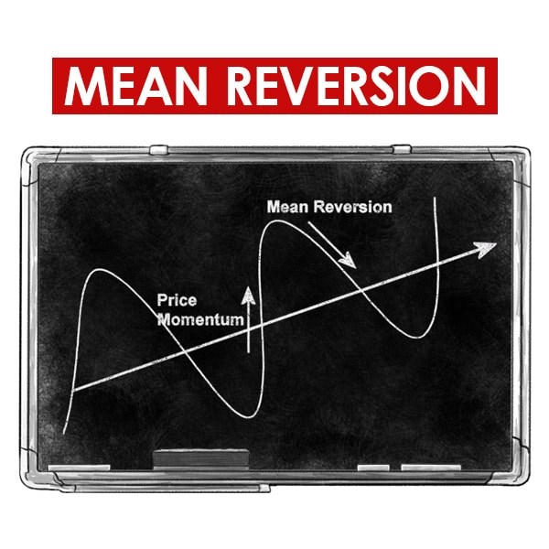
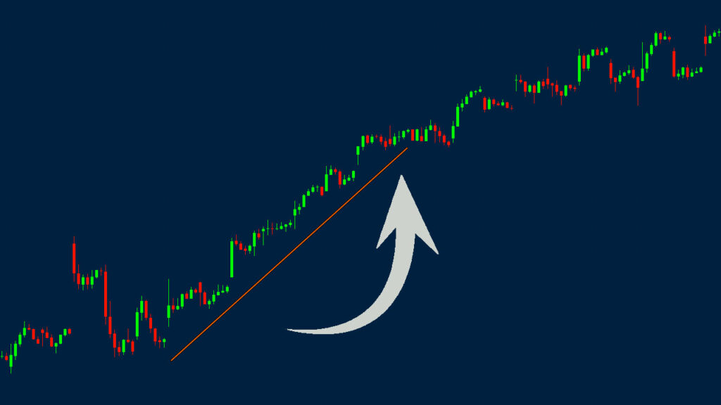
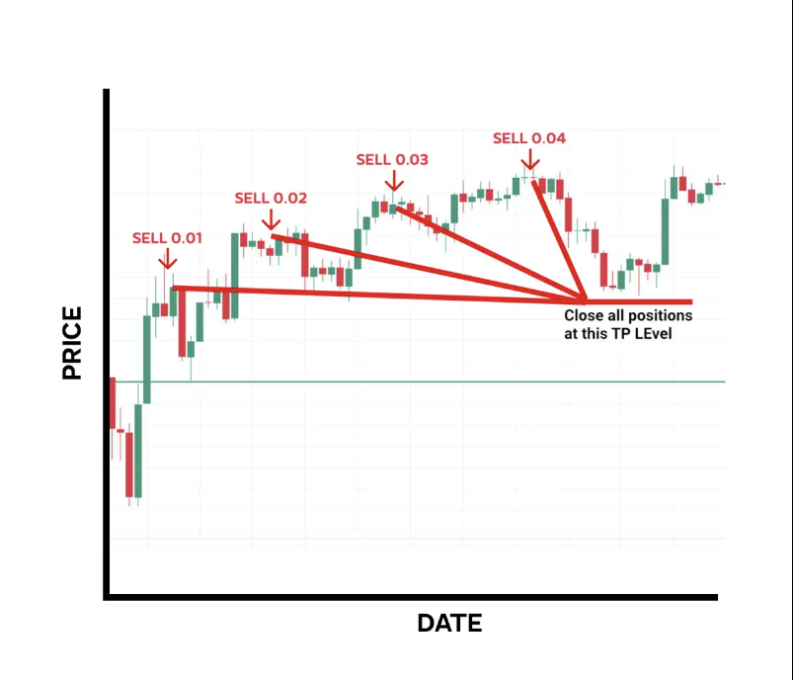
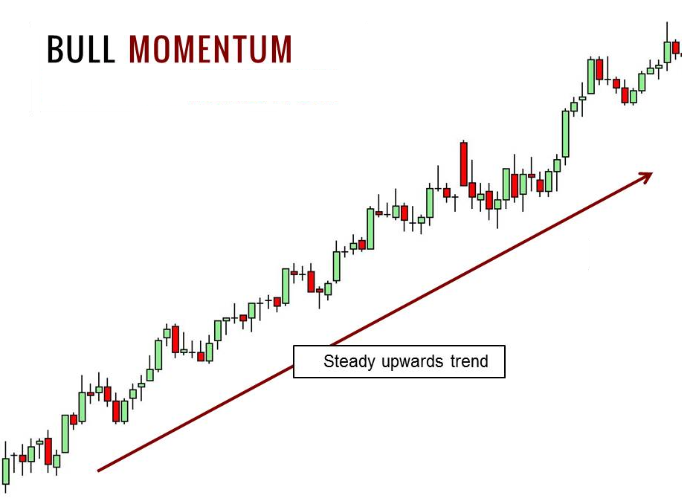
Strategy Overview
Trend Following
Active Strategies:
1. Mean Reversion
2. Trend Following
3. Momentum
4. Martingale Strategy
Passive Strategy
5. Buy & Hold
Martingale Strategy

Slide 8
Martingale Strategy
If the previous trade is a win then trade the base amount next time.
If the trade is a loss then double the trade amount for next time.
This trades everyday the only thing that changes is the trade size.
Martingale Strategy

Slide 9
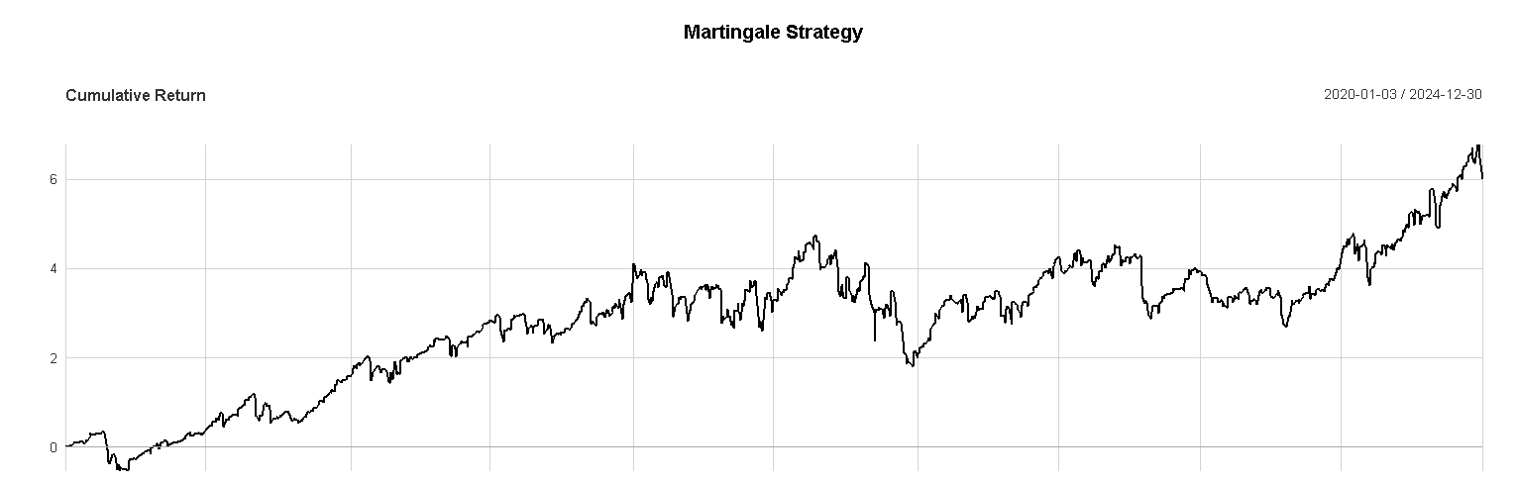
Martingale Strategy Graph

Slide 10
Trend Following Strategy
Buy when the stock rises above its 20 Day SMA
Sell when the price falls beneath its 20 DAY SMA
Trend Following

Slide 11
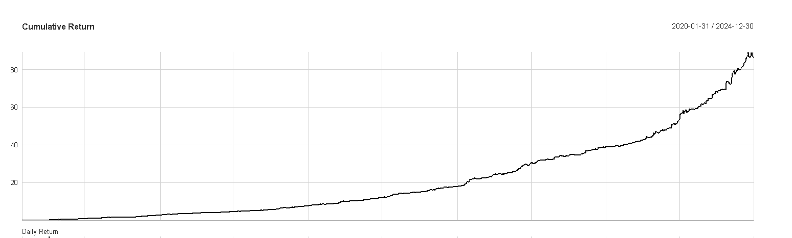
Trend Following Strategy Graph

Slide 12
Mean Reversion Strategy
Buy when the price is less than the SMA (Standard Moving Average) of 10 days.
Sell when the price goes back above the 10 Day SMA.

Slide 13
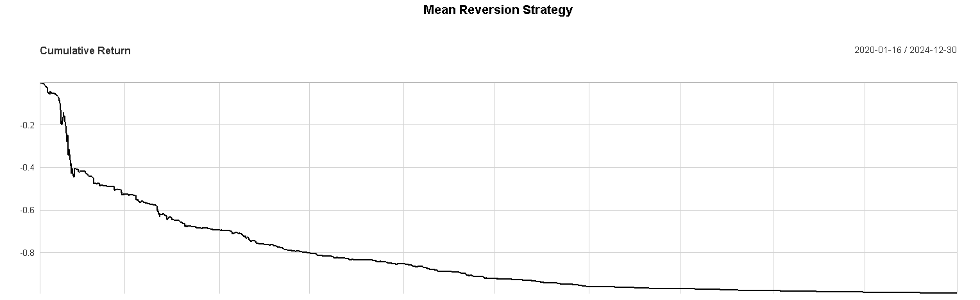
Mean Reversion Strategy Graph

Slide 14
Momentum (RSI Based) Strategy
Buy when the 14 day RSI drops below 30. (This indicates that the stock is oversold.)
Sell when the RSI rises back above 30.

Slide 15
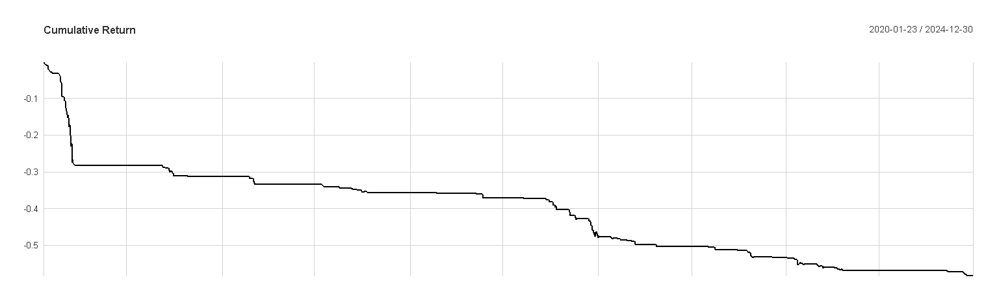
Momentum (RSI Based) Strategy Graph

Slide 16
Buy & Hold Strategy
Buy at the first day of the time period in our case its 01-01-2020.
Sell on the last day which is 12-31-2024.
Baseline case(passive)

Slide 17
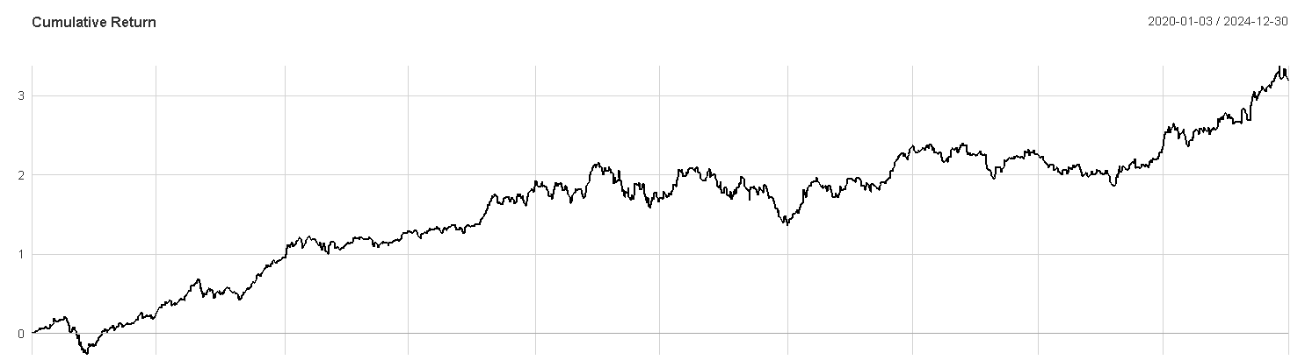
Buy & Hold Strategy Graph

Slide 18
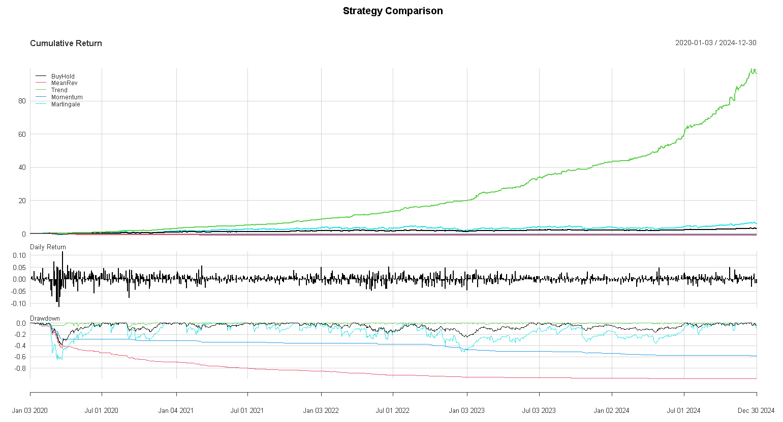
Strategy Return Graph

Slide 19
Performance Metrics Table
Strategy | Sharpe | Max Drawdown | Volatility | Total Return
Martingale | 0.05828933 | 0.6566211 | 0.6559917 | 6.003354 %
Mean Reversion | -0.31674849 | 0.9911637 | 0.1848727 | -0.9911637 %
Trend Following | 0.3555976 | 0.06235012 | 0.1613804 | 86.20124 %
Momentum | -0.1638110 | 0.5839733 | 0.06671779 | -0.5837242 %
Buy and Hold | 0.07591405 | 0.3925279 | 0.2683314 | 3.18188 %

Slide 20
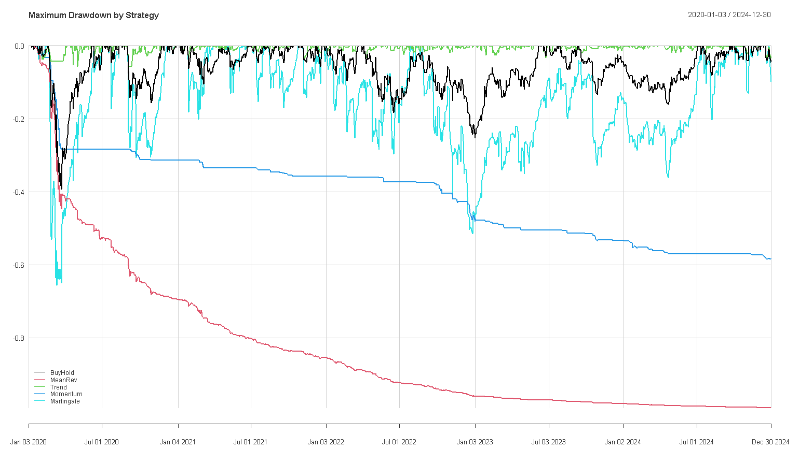
Risk Analysis

Slide 21
Key Findings
The best performing strategy was the Trend Following Strategy.
The most stable was also the trend following strategy.
The worst performing strategy was Mean Reversion.

Slide 22
Limitations
Because of lack of time and knowledge around R we ended up using very basic strategies with no optimizations or adaptivity.
We only tested 4 stocks also due to time and that could cause our results to not generalize to the rest of the market sectors.
There is no intraday trading since we are going only off of daily data.

Slide 23
Future Work
Some possible ideas for extending this project could be -
Using Machine Learning
Incorporating ETFs like SPY or QQQ
Using Intraday Data
Risk Management with trade sizes based on volume

Slide 24
Conclusion
Active Strategies:
  Martingale Strategy: Previous trade is a win, so trade the base amount next time.
  Mean Reversion Strategy: Buy as the price is less than the SMA of 10 days.
  Trend Following: Buy as the stock rose above its 20 Day SMA
  Momentum Strategy: Buy as the 14 day RSI drops below 30, indicating that the stock is oversold
Passive Strategy:
  Buy and Hold Strategy: Our strategy of buying at the first day of the time period (01-01-2020) and selling on the last day (12-31-2024) was successful.

Slide 25
References
An Introduction to R, cran.r-project.org/doc/manuals/r-release/R-intro.pdf. Accessed 8 Aug. 2025.
Quantmod.Pdf - Cran, cran.r-project.org/web/packages/quantmod/quantmod.pdf. Accessed 8 Aug. 2025.
“Performanceanalytics: Econometric Tools for Performance and Risk Analysis.” The Comprehensive R Archive Network, Comprehensive R Archive Network (CRAN), 9 Dec. 2024, cran.r-project.org/web/packages/PerformanceAnalytics/index.html.
R-Project, cran.r-project.org/web/packages/TTR/TTR.pdf. Accessed 8 Aug. 2025.
“Stock+Market Images – Browse 3,945,933 Stock Photos, Vectors, and Video.” Adobe Stock, stock.adobe.com/search?k=stock%2Bmarket. Accessed 7 Aug. 2025.
“Yahoo Finance | Yahoo Mobile CA.” Yahoo!, Yahoo!, ca.mobile.yahoo.com/finance. Accessed 7 Aug. 2025.
“Yahoo Finance: Stocks & News - Apps on Google Play.” Google, Google,
play.google.com/store/apps/details?id=com.yahoo.mobile.client.android.finance&pli=1. Accessed 7 Aug. 2025.

